Slide 1
Section III: Splitting Methods for Solving LCPs

Slide 2
Splitting Methods for Solving LCPs
Notes:
I will start with a general linear complementarity problem. The solution to this is given by any lambda that is complementarity to the affine relation given by the matrix A and the vector b. For now, I keep things general and make no assumptions about the matrix A and the vector b.
CLICK
In the next step I introduce the idea of splitting the A matrix into two terms that we call M and N. Later I will get back to how exactly these M and N matrices may look like. For now, I just assume I have such a splitting such that A would be equal to M minus N.
CLICK
Given this splitting I insert it into the definition of the given linear complementarity problem and arrive at this new form.

Slide 3
Splitting Methods for Solving LCPs
Notes:
CLICK
The next secret ingredient I add to the mix is to introduce iteration indices to the split version of the linear complementarity problem. Here I use k as the iteration index. I use k plus one for all terms except the lambda term that is multiplied with the N-matrix.
CLICK
Next, I introduced the c-vector which depends only on the k’th iteration lambda value.
CLICK
The k’th linear complementarity problem now algebraically look like this.. Hence, when solving the k’th linear complementarity problem all k-values are given to us, and I only need to solve for the lambda k plus one value. The whole idea behind the splitting and the iteration process is that I hope to replace a difficult linear complementarity problem that was given by the A-matrix with a sequence of simpler problems that individually are easier to solve. I need to create the splitting of the A-matrix into the M and N matrices such that this happens. More about this later on.
CLICK
For now, I can observe that if the sequence of lambda solutions converge then the limit point will be a solution to the original linear complementarity problem.
CLICK

Slide 4

Splitting Methods for Solving LCPs
Notes:
Let me clean up what I have so far.
I have created a sequence of sub linear complementarity problems where I know if they converge to a fixed point as k goes to infinity then I have found a solution for my original linear complementarity problem.
CLICK
My hope is that the splitting of the A matrix into the M and N matrices make the subproblems very easy to solve.
Hence, my next step in my derivation is to find a clever way to solve these sub-problems.

Slide 5
Splitting Methods for Solving LCPs
Notes:
I will now use a minimum map reformulation of the linear complementarity problem to convert it into a non-smooth root search problem.
CLICK
The minimum map reformulation simply takes the component-wise minimum between the lambda k plus one vector and the vector given by the linear relation. I write the reformulation like show here. Observe, that it is a vector equation, the left side takes the component wise minimum of its vector inputs.
CLICK
This type of reformulation opens up the doorway for many different types of non-smooth methods. There exist many different types of functions like psi that can recast a complementarity problem into a non-smooth root search problem. I will show other examples later in this course. Such functions are called non-linear complementarity problem functions or ncp functions for short.

Slide 6
Splitting Methods for Solving LCPs
Notes:
I will now build a bit more intuition about this minimum map reformulation before I move on with my derivation.
CLICK
I will consider two real numbers x and y. If these are complimentary to each other then it means that if one is positive, then the other must be zero.
CLICK
This can be rewritten to require that both numbers are non-negative, and their product must be zero.
CLICK
Often the orthogonal symbol is used to write up the meaning of these equivalent statements. This is more more readable and convenient to write down.
CLICK
Now I will do a case-by-case analysis based on the signs of the x and y variables. This means I have 3-by-3 table of all possible sign combinations.
CLICK
Looking at the table I observe that only the sign combinations that results in zero are equivalent to the solutions to the complementarity definition . Hence, this shows clearly that the minimum map reformulation did not change the solution to the linear complementarity problem I am trying to solve.

Slide 7
Splitting Methods for Solving LCPs
Notes:
Now I have convinced myself that the minimum map reformulation algebraically is equivalent to a complementarity condition so now I will look at how this function is shaped. Here I plot the minimum value of two real numbers a and b. I see that I get this tent like shape
CLICK
I notice it is the zero-level iso-contour that corresponds to valid complementarity solutions. Observe that a large part of the tent shape is smooth, only in the line a=b is the tent non-smooth.

Slide 8
Splitting Methods for Solving LCPs
Notes:
If I introduce an affine relationship between the y and x variables using the coefficients a and b then I have a one dimensional linear complementarity problem. I can now very easy study the graph of the minimum map of the one dimensional linear complementarity problem for different values of the coefficients a and b.
CLICK
I clearly see the cusp in the transition between the two input parameters. Marked by the star shapes.
CLICK
Any intersection point with the zero-line in this plot is a solution to the one dimensional linear complementarity problem. I mark them here with yellow circles.
CLICK
I notice that the purple curve that has negative coefficients has no solutions.
The other observation is that the intersection points are on straight lines and there are only two straight lines to consider.
This is the insight I need for developing the sub-solver.
I want to do a case-by-case analysis to figure out which line the solution is on and then compute the intersection.
Armed with the idea of how to solve the minimum map reformulation I will now return to the N dimensional linear complementarity sub problem from the splitting approach.

Slide 9
Splitting Methods for Solving LCPs
Notes:
So I have our minimum map reformulation of the sub-problem from the splitting
CLICK
Then I subtract lambda k+1 from this equation
CLICK
Hereafter I multiply by minus one, doing this means the minimum becomes a maximum and the signs of both inputs are flipped. I now recognize that the root-search problem I had from the minimum map reformulation has been converted into a fixed-point problem. As I have lambda k plus one values on both sides of the equation.

Slide 10
Splitting Methods for Solving LCPs
Notes:
So, the fixed-point formulation gave me this non-smooth equation to solve. I will now consider only the i’th component of this non-smooth vector equation and do a case-by-case analysis.
CLICK 1
Two cases are relevant depending on the sign of the non-zero input argument. One case is for non-positive numbers and the other for positive numbers.
CLICK 2
I immediately see that the non-positive case has the simple solution of setting lambda equal to zero. The positive case looks a little trickier as I have a linear system on the left-hand side. Hence, I will try and simplify the case a little more to clean it up.
CLICK 3
I now get a simpler linear system. It is still painful because I only want the i’th component of the matrix vector product on the left side. Hence, in the general case I can not just invert the matrix to move it to the right-hand side of the equation.
However, for very specific choices the inversion can be done, so with that note in mind I arrive at the next equation.
CLICK 4
I now have the solution for the positive case.
CLICK 5
At this point it may appear a little wild that I inverted the M-matrix. However, clearly there will exist valid choices. Just consider that the M-matrix is equal to the diagonal part of the A-matrix then the inversion of each component is independent of each other and clearly possible. This choice is called a Jacobi method. I will later present other choices, some of these implies a specific order on the i-index.

Slide 11
Splitting Methods for Solving LCPs
Notes:
I now have all pieces in place to formulate the first general version of a splitting method. I will now summarize. From the fixed-point formulation, I derived two cases for finding the solution for the i’th component of lambda k plus one.
CLICK 1
If I recall the definition of the c-vector and substitute this into the fixed-point formulation, then I get this
CLICK 2
I will now define the helper variable z with this I can now write up the solution update as a projection of the z-vector.
CLICK 3
Therefore, this whole class of splitting methods I have deriving are called projection methods.

Slide 12
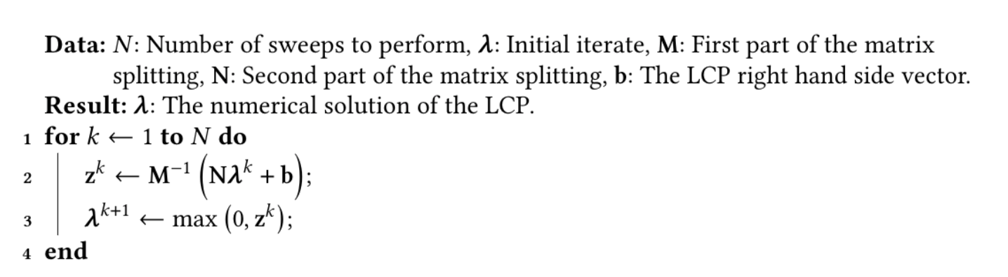
Splitting Methods for Solving LCPs
Notes:
I will just show how the final algorithm looks like to give an idea of how to implement this in a simple way.
Notice this is simply a for loop that in each iteration computes the value of the z-vector and then projects it to find the updated lambda value.
The outer loop is solving for the fixed point to the sequence of sub linear complementarity problems and the projection inside the for loop is solving the actual linear complementarity sub problem.
Here I just used a fixed number of iterations for stopping the outer loop. In a real implementation one would use stopping criteria that tests for how close one is getting to a fixed point.

Slide 13
Splitting Methods for Solving LCPs
Notes:
I can now introduce more choices for the splitting that will work in this scheme I have derived. To do so I will introduce notation that splits our A matrix into a strict lower triangular part, a diagonal part and a strict upper triangular part.
CLICK 1
I call these sub parts for L, D and U as shown here. Using this notation, I can now write up the splitting choices for the three most common methods that are used.
CLICK 2
The first row is the projected Jacobi method, the second row is the projected Gauss-Seidel method, called PGS for short, and the last row is the projected successive over relaxation method, called PSOR for short.
The omega parameter is called the relaxation parameter and it is a free parameter selected by the end-user. Its value can range from zero to two.
CLICK 3
Omega can be used to tune the convergence behavior. For this reasons PSOR is preferred over PGS. Observe that if omega is equal to one then PSOR becomes PGS.
PSOR is many times preferred over the projected Jacobi method too because in practice is shows better convergence in many cases. However, there are cases where the Jacobi method is preferred.
The main difference from these choices is that the Jacobi method can update all components in parallel, but it can not do in place updates. The PGS and PSOR versions comes with order dependency the components must be solved in increasing order, but this allows them to use in place updates.
One can specialize the splitting method for the PGS and PSOR versions to produce a very simple and nice-looking update equation. I will show how to do this next.

Slide 14
Splitting Methods for Solving LCPs
Notes:
I will start by investigate the PSOR splitting choice to see what this omega business is actual doing. I will start by writing up the definition of the splitting of the A matrix and substitute in the PSOR choice.
CLICK-1
I can now clean up a little this equation
CLICK-2
I observe that this is just omega multiplied with L plus D plus U. Now the sum of L, D and U is A
CLICK-3
So, M minus N is just omega multiplied by A. I can get this into the linear complementarity formulation by writing it like this
CLICK-4
Observe that if omega is a positive number this definition of the relaxed linear complementarity problem has the same solutions as the unrelaxed version.
You may be wondering what this omega parameter is good for, one way to think about it is that it rescales the A-matrix. If you remember the minimum map reformulation plots, then the effect of omega is to change the slope of the second straight line. There are other interpretations of omega as well, but I will not get into this right here.

Slide 15
Splitting Methods for Solving LCPs
Notes:
Now that I understand the role of omega a little better, I will move on with deriving a nice update equation for the PSOR method.
CLICK 1
Remember the fixed-point formulation I showed for the general splitting with M and N.
CLICK 2
I will now use the PSOR choices for M and N and substitute them into the general fixed-point reformulation.
Then I will look at the positive case for the i’th component.
The aim is now to isolate the i’th component of the lambda k+1 term on the left side of this equation.
Remember the problem is if we can “invert” the M matrix. The PSOR choice will give a beautiful solution to this headache as I will show on next slide.
Before doing this, I will just convert the matrix multiplications into index notation
CLICK 3
Observe how the matrix multiplications now are given by sums over the columns of L and U.
I already exploited the fill pattern of the matrix to avoid summing over entries in these matrices that I know is zero.
The L term multiplied by lambda k+1 is interesting.
CLICK 4
The headache is that I only want to solve for the I’th component of lambda k plus one.
Here I have a whole lot of lambda k plus one components.
However, I only have components where j is less than i. So, if I assume that I solve for components using increasing i-order then this whole term is actually not unknowns but are now known values and can be moved to the right-hand side of the equation.
CLICK 5
After this all that are left is to divided by the D i i term to get the equation I am looking for
CLICK 6
CLICK 7

Slide 16
Splitting Methods for Solving LCPs
Notes:
So, I have the main building block of the PSOR update rule now. The next steps is a matter of making the math look a little more pretty.
CLICK 1
First, I factor all terms multiplied by omega
CLICK 2
CLICK 3
and then the term that are not multiplied by omega
CLICK 4
CLICK 5
Next step is to realize that I do not need to have a lambda k and a lambda k plus one. In the i’th update I only ever write to the i’th entry of the lambda vector, and I only read from the entries with j less than i. So this means I can use the same lambda vector. This is called in-place update.
CLICK 6
If I define the r vector to be the residual vector like this
CLICK 7
Then I observe that my update formula is using the the i’th component of the residual vector
CLICK 8
CLICK 9
Substituting the r-vector into the update equation I can now finally write up the projection for PSOR
CLICK 10
I observe this nice and simple algebraic form that are implementation friendly.

Slide 17
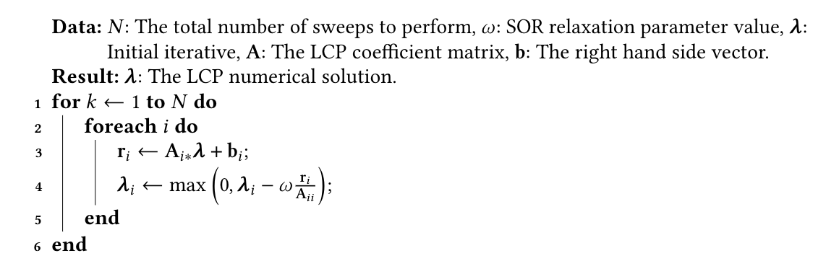
Splitting Methods for Solving LCPs
Notes:
I can now finally present the specialized PSOR method for solving a linear complementarity problem.
Observe the outer loop iterates over the sequence of linear complementarity problems, while the inner loop sweeps over all the components in increasing order and update them. Remember the for loop came from the L-term that went into the M matrix when doing the splitting. It requires all lambda components before the i’th one to have been solved before solving the i’th component.

